Slide 1


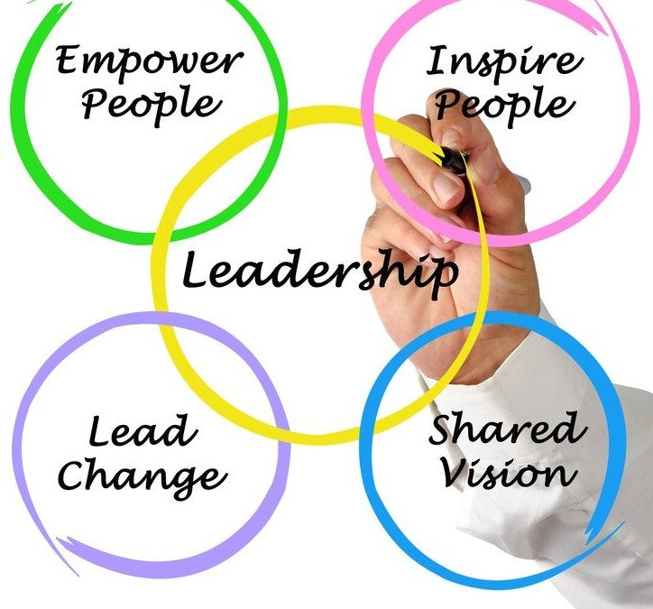

Leadership
Instructor: Dr. Muhammad Rafiq
Chapter 12: Organizational Behavior – 15th Edition

Slide 2
Leadership
What is leadership?
What comes to your mind when you see this word?
Name some leaders
Who are they?
What did they do?

Slide 3
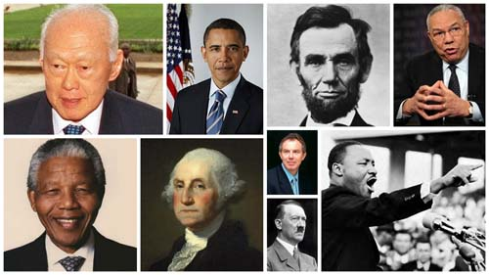
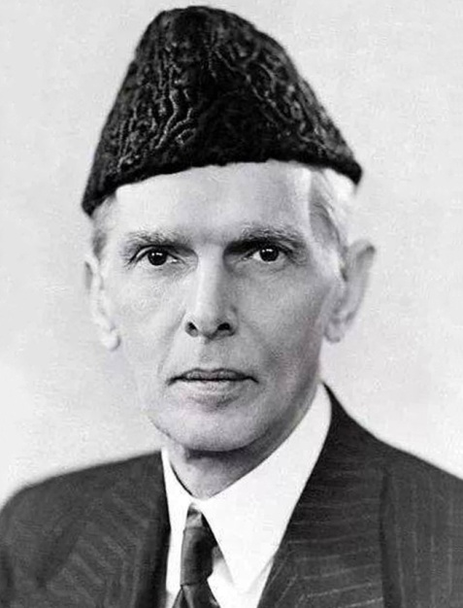
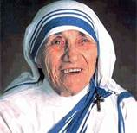

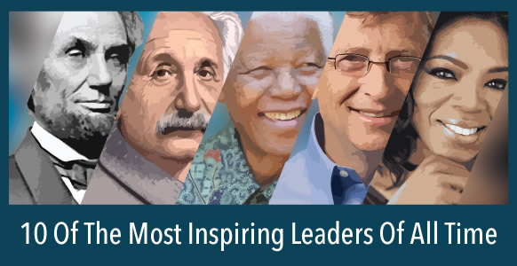
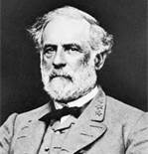
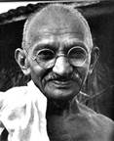
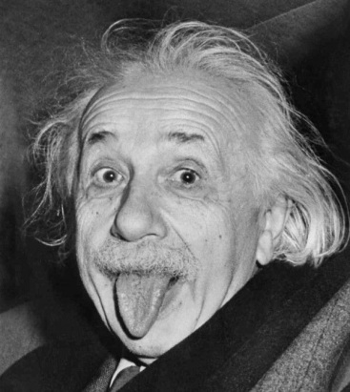
What makes someone a leader?

Slide 4
Leaders are Made or Born?
Trait Theory
Skill development Theory
OR
Blend of both
Notes:
Amal se zindgi banti hai, Jannat bhi Jhanam bhi,
Yeh khaki apni fitrat main na noori hai na nari,
My position is made, not born

Slide 5
Leadership
Is a process which involves the use of noncoercive influence.
Is a property - the set of characteristics attributed to someone who is perceived to use influence successfully.
Is influence - the ability to affect the perceptions, beliefs, attitudes, motivation, and/or behavior of others.
Drive, Desire to Lead, Integrity (Trust, Consistency, Role Model), Self Confidence, Intelligence (Ability to analyze), Job Relevant Knowledge
Notes:
What or who is a leader?
- A leader is considered to be an individual who guides, conducts, directs, and influences.
- What is meant by a good leader? Good leaders are able to get more done with the resources given to them because they know that there comes a point where the increasing effort just isn’t worth the expense required to achieve to the effort.

Slide 6
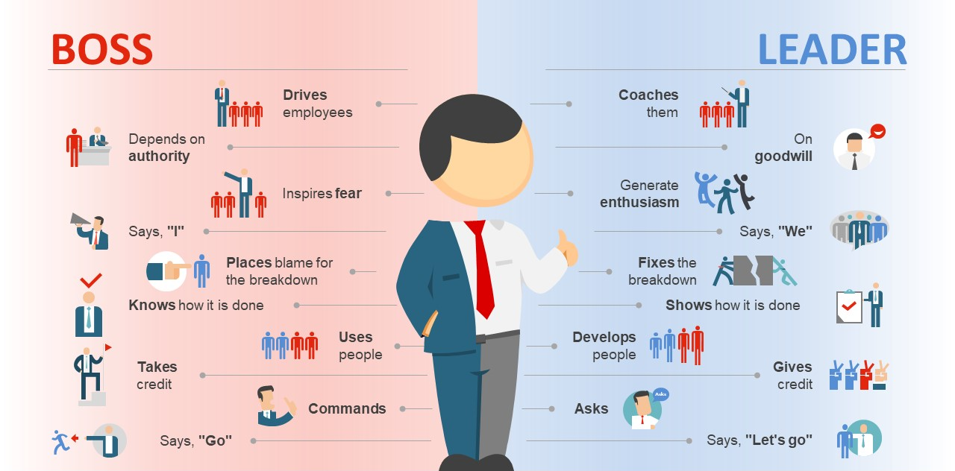
Management and Leadership

Slide 7
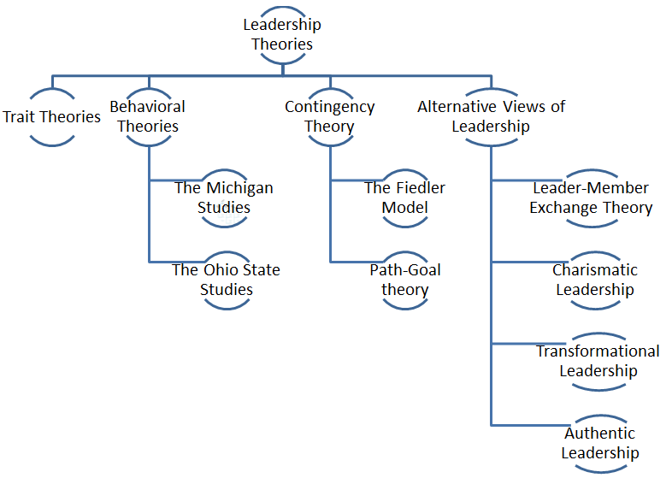

Slide 8
Trait Approaches to Leadership
Leadership traits: identifying personal characteristics that differences leaders from non-leaders:
Intelligence
Dominance
Self-confidence
Energy
Task-relevant knowledge
Drive
Desire to lead
Honesty/integrity
Self-confidence
Cognitive ability
Knowledge of the business
Notes:
Trait Approaches to Leadership
Attempts to identify stable and enduring character traits that differentiate effective leaders from non-leaders focusing on:
Identifying leadership traits
Developing methods for measuring them - Using the methods to select leaders

Slide 9


Behavioral Theories of Leadership
Leadership theories that identified behaviors that differentiated effective leaders from ineffective leaders.
Two complementary theories
University of Michigan Studies
Ohio State University Leadership Studies
Major dimensions of leader behavior
Task-centered behavior
People-centered behavior
Early Studies in Behavioral Approaches to Leadership
The Michigan Studies
The Ohio State Studies

Slide 10
Behavioral Theories of Leadership (Cont.)
The University of Michigan Studies
Job-centered leader behavior
Task focused
Pressured subordinates to perform
Little concern for people
Did not trust people to work on their own
Close supervision
Little understanding of their work unit's social system
Did not set high performance goals
Paying close attention to the work of subordinates, explaining work procedures, and demonstrating a strong interest in performance

Slide 11
Behavioral Theories of Leadership (Cont.)
The University of Michigan Studies
Employee-centered leader behavior
Focused on people and their personal success
Understood of their work unit's social system
Set high performance goals
Communicated performance expectations to subordinates
Attempting to build effective work groups with high performance goals
Combined a strong concern for the social aspects of the work unit with high performance expectations
Notes:
The University of Michigan Studies (cont.)
Research results
Employee-centered leadership: higher work unit performance than job-centered leadership
Job-centered leadership: high productivity with several latent dysfunctions
Poor employee attitudes
Higher turnover or absenteeism
Little group loyalty
High levels of distrust between subordinates and leaders

Slide 12
Alternative Views of Leadership
Leader-Member Exchange Theory
Charismatic Leadership Theories
Transformational Leadership
Authentic Leadership

Slide 13
Alternative Views of Leadership (Cont.) 1. Leader-Member Exchange (LMX) Theory
LMX argues that, because of time pressures, leaders establish a special relationship with small group of their followers.
Leaders create in-groups and out-groups and subordinates with in-group status will obtain more attention of leader that is linked to higher performance ratings, less turnover, and greater satisfaction with their superior.
A Leadership theory that provides a set of rules to determine the form and amount of participative decision making in different situations.

Slide 14
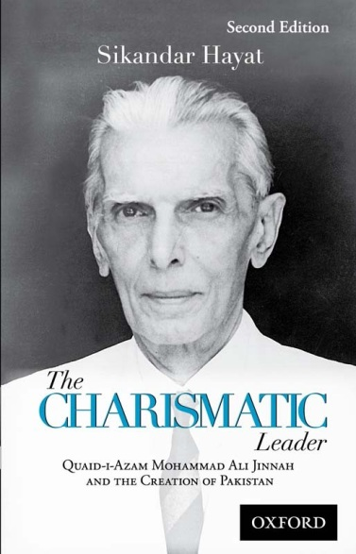
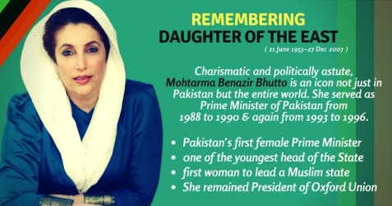
Alternative Views of Leadership (Cont.) 2. Charismatic Leadership Theory
Followers make attributions of heroic or extraordinary leadership abilities when they observe certain behaviors (ex - Martin Luther King)
Leader - develop and widely communicate an inspirational vision.
Leader - form bonds of trust between themselves and their followers.
Leader – sensitive to follower needs
Leader - Attract devoted followers
Followers - energetically pursue leader's vision
Followers - move to extraordinary heights of performance
Followers - build emotional attachment to leader.
Notes:
Individuals who inspire followers through their words, ideas, and behaviors.

Slide 15
Alternative Views of Leadership (Cont.) 3. Transformational Leadership
Leaders who inspire followers to go beyond their own self-interests for the good of the organization and who are capable of having a deep and extraordinary effect on followers.
Leader’s transform their followers through their inspirational nature such that followers identify with the leader and its purpose.
Focus on change and communicate clear vision
Address the needs and values of the organization
Address the needs and values of followers
Strive for big increases in performance
Bring excitement to workplace
Build strong emotional bonds between subordinates
Often bring dramatic changes to an organization's culture

Slide 16
Alternative Views of Leadership (Cont.) 4. Authentic Leadership
Leaders who know who they are, know what they believe in and value, and act on those values and beliefs openly and candidly. Their followers would consider them to be ethical people.
Authentic leaders share information, encourage open communication, and stick to their ideals.
The result: people come to have faith (trust) in them.

Slide 17
Types of leadership in 21st century
Paradoxical leadership
Resilience leadership
Eco-leadership
Digital leadership
Notes:
Digital Leadership: A modern approach where leaders leverage digital tools, data analytics, and AI to drive organizational change, enhance decision-making, and optimize performance. Digital leaders balance technology with human-centric strategies.
Eco-Leadership: Leadership that integrates principles of sustainability and environmental stewardship into business practices, promoting regenerative and eco-friendly strategies to benefit society and the planet.
Paradoxical Leadership: The ability to embrace and manage opposing demands, such as stability versus change or control versus autonomy, without trying to resolve the tensions. This approach encourages a balance to achieve long-term success.

Slide 18
Summary and Implications for Managers
Trust is important - as organizations are less stable, personal trust is key in defining relationships and defining expectations
Transformational leaders are in demand. Organizations want leaders with vision and charisma to carry out the visions.
Invest in leadership selection and training (and follow up with assessment centers, courses, workshops, rotating job responsibilities, coaching, and mentoring)

